Slide 1
4 CT I / P’s
Controlling and Database
Full Features Main Working Version : 1
24 Battery Voltage Inputs
24 Battery Temperature Inputs
Dashboard and data display in prescribed format with reports outputs with SQL query generator and reports downloader on same.
Historical data analysis on inputs.
15 Site Alarms Inputs
GPS
3 MCB Controls (6 CT I / P’s for controls)
Camera I/P
Room Temp / Humidity
Lock Open O/P
DG On / Off
Fuel Level inputs

Slide 2
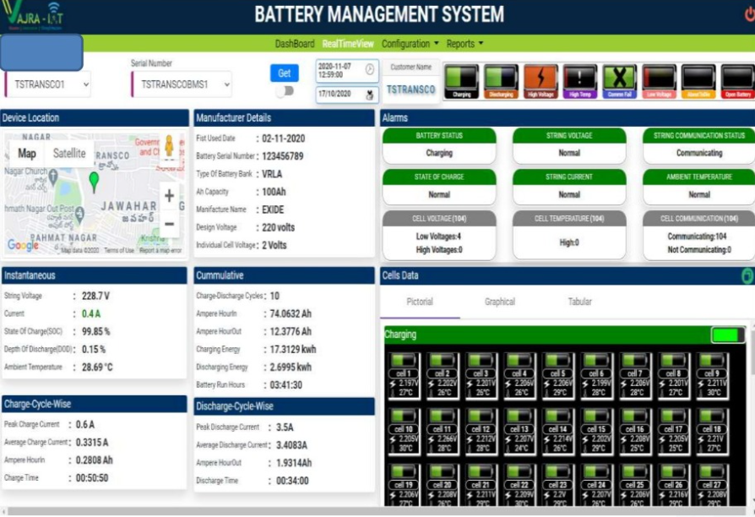

Slide 3
2 Ultrasonic Sensors I / P’s
Controlling and Database
Blind / Old Age stick and Wheel chair
1 temperature Sensor I/P
Heart Rate monitor I/P
Real time data to be captured , Route mapping on Goole maps , Voice interactive App for Blind.
Body Temperature I/P
Gyroscope I/P
Device Interface with App with BLE
GPS I / P For Wheelchair

